Slide 1
Recipe preparation agent
CAPSTONE PROJECT
Presented By:
1. Aastha Pant-Graphic Era Deemed to be University-B.Tech.(CSE_AI)

Slide 2
OUTLINE
Problem Statement
Proposed System/Solution
System Development Approach
Algorithm & Deployment
Result (Output Image)
Conclusion
Future Scope
References

Slide 3
Problem Statement
Example: In daily life, individuals often struggle to prepare meals with limited ingredients available at home. Searching for suitable recipes manually wastes time and can result in food wastage or underutilization of ingredients. There’s a need for an intelligent system that helps users find practical recipes using only what’s already in their kitchen, accommodating dietary preferences or restrictions as well.

Slide 4
Proposed Solution
We propose a Watsonx-powered Recipe Preparation Agent that helps users find meals based on the ingredients they currently have at home. This AI assistant is designed using Retrieval-Augmented Generation (RAG) and leverages IBM Watsonx services to retrieve and generate cooking steps and suggestions.
Step-by-step overview:
1. User Input: The user enters a list of ingredients (e.g., "onions, rice, and tomatoes").
2. Vector Search: Using IBM Watsonx Knowledge Base (vector index), the agent searches the uploaded `.txt` file for recipes that match or relate to the entered ingredients.
3. Response Generation: The AI generates step-by-step instructions using the prompt logic tailored for cooking guidance.
4. Smart Substitutions: If any ingredient is missing, the agent suggests possible replacements.
5. Sustainability: This system helps reduce food waste by providing usable recipes from available pantry items.
Key Highlights:
– Uses IBM Watsonx RAG for intelligent recipe retrieval
– Minimal setup using IBM Cloud Lite’s free tier
– Simple `.txt` file as the knowledge base for recipe storage
– Custom prompt to deliver natural and human-like cooking suggestions

Slide 5
System Approach
Technologies Used:
– IBM Watsonx.ai (Agent Lab)
– IBM Watsonx Knowledge Base (Vector Index)
– Retrieval-Augmented Generation (RAG) Model
– IBM Cloud Lite Free Tier
Tools & Files:
– Custom `.txt` file with recipe ingredients and steps
– No third-party libraries or external datasets used
– IBM-generated runtime and sandbox project
Process:
1. Project creation in IBM Cloud (Watsonx sandbox)
2. Upload `.txt` corpus into knowledge base
3. Configure RAG Agent with prompt and vector index
4. Test and deploy live AI Assistant

Slide 6
Algorithm & Deployment
Here's an example structure that gives the preview of our solution in this section:
Algorithm Selection:
Retrieval-Augmented Generation (RAG) model. Embeds query and recipe text using vector embeddings. Searches indexed documents and generates tailored response.
Steps:
User enters available ingredients. Agent retrieves closest recipe entries via vector search. Generates steps with substitutions if needed.
Deployment:
Built and deployed within IBM Watsonx Agent Lab . Deployed as a chat-based assistant and can be reused in customer-facing interfaces or embedded Uis.

Slide 7
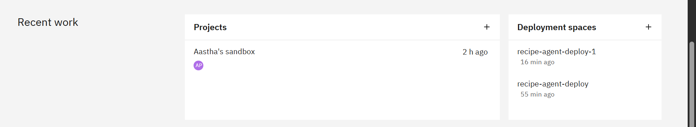
Result
This depicts the name of the project as well as the deployment space for the same.

Slide 8
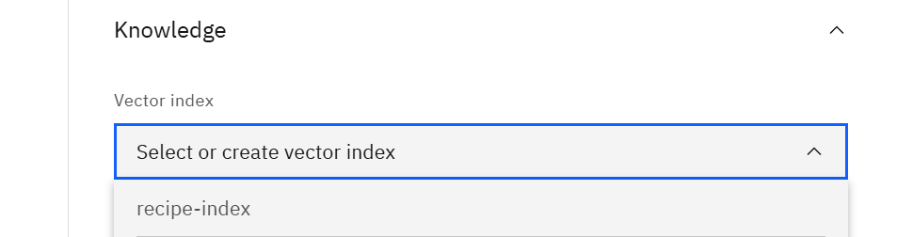
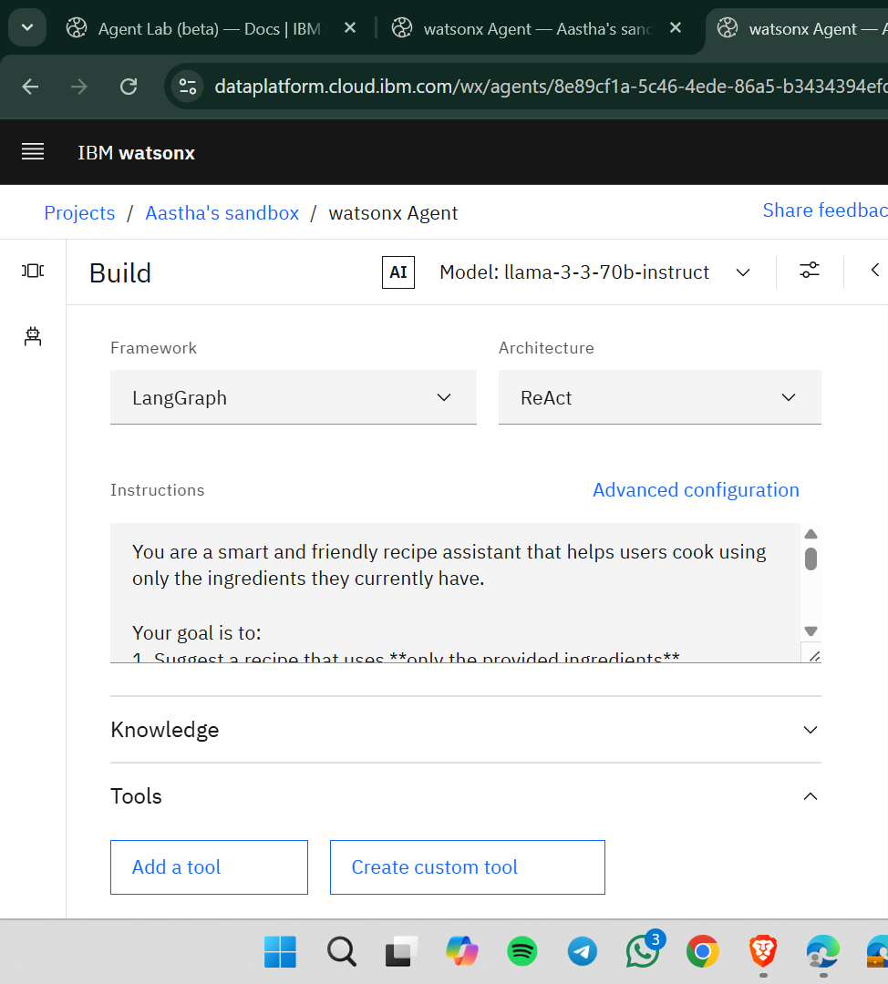
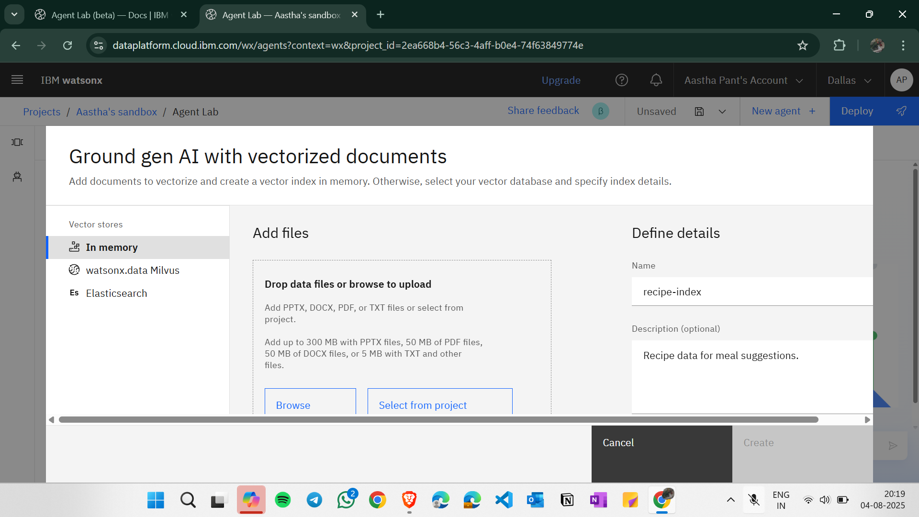
Result
Presenting the instructions and introducing RAG lab factor here by adding txt file/pdf.

Slide 9
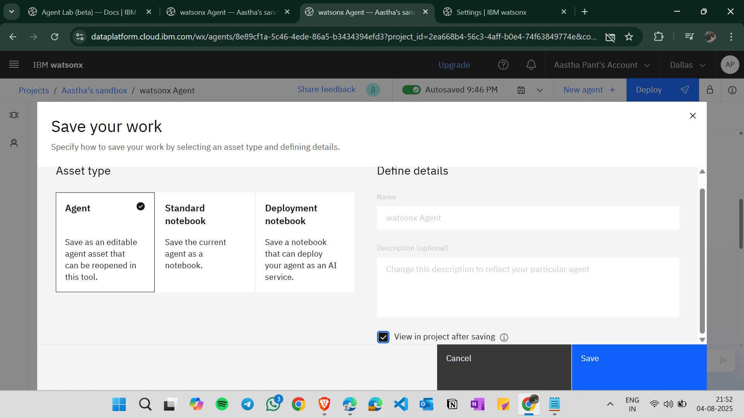
Result
Saving.

Slide 10
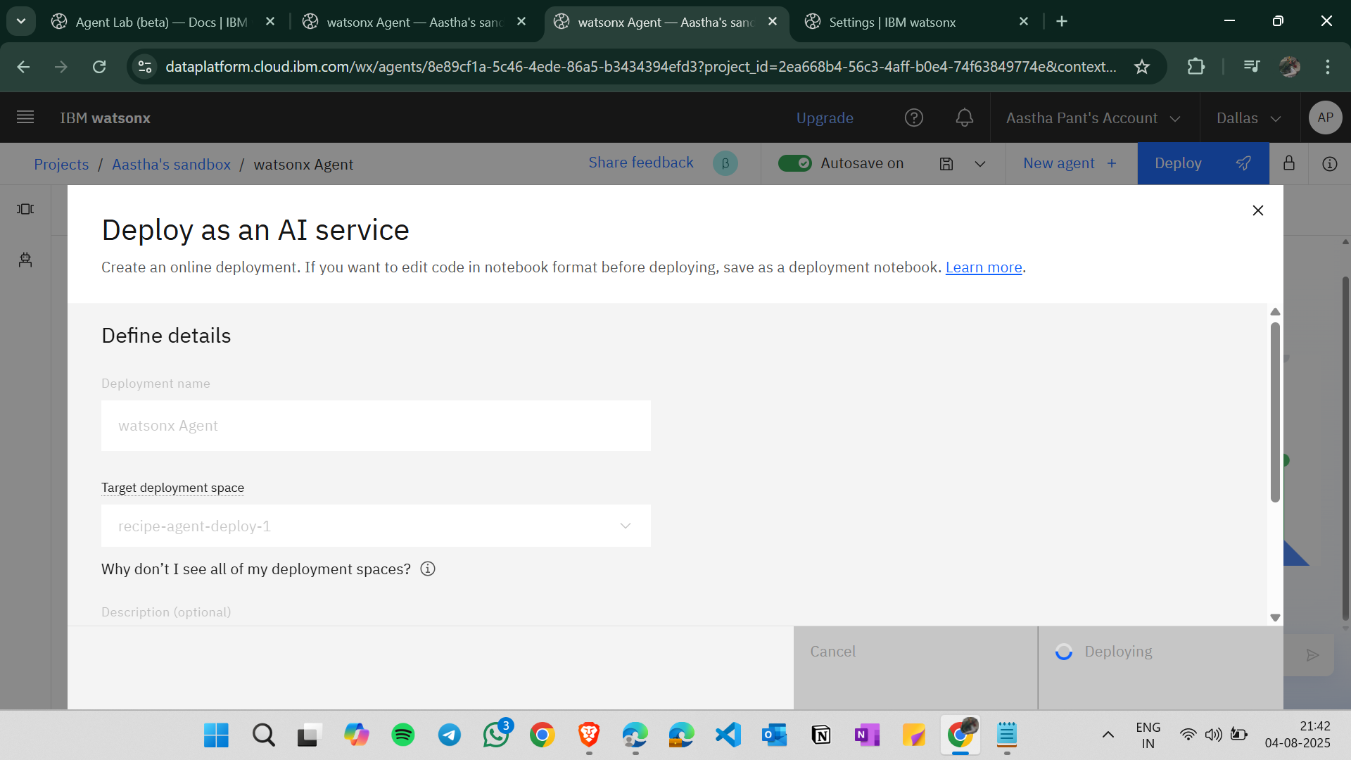
Result
Deployment.

Slide 11
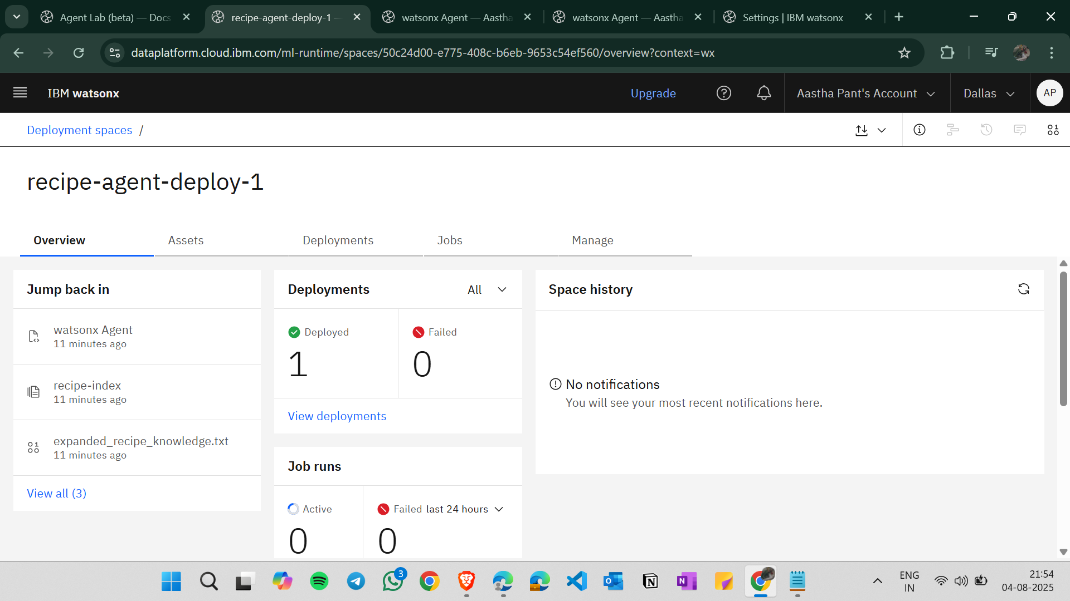
Result
Successful Deployment.

Slide 12
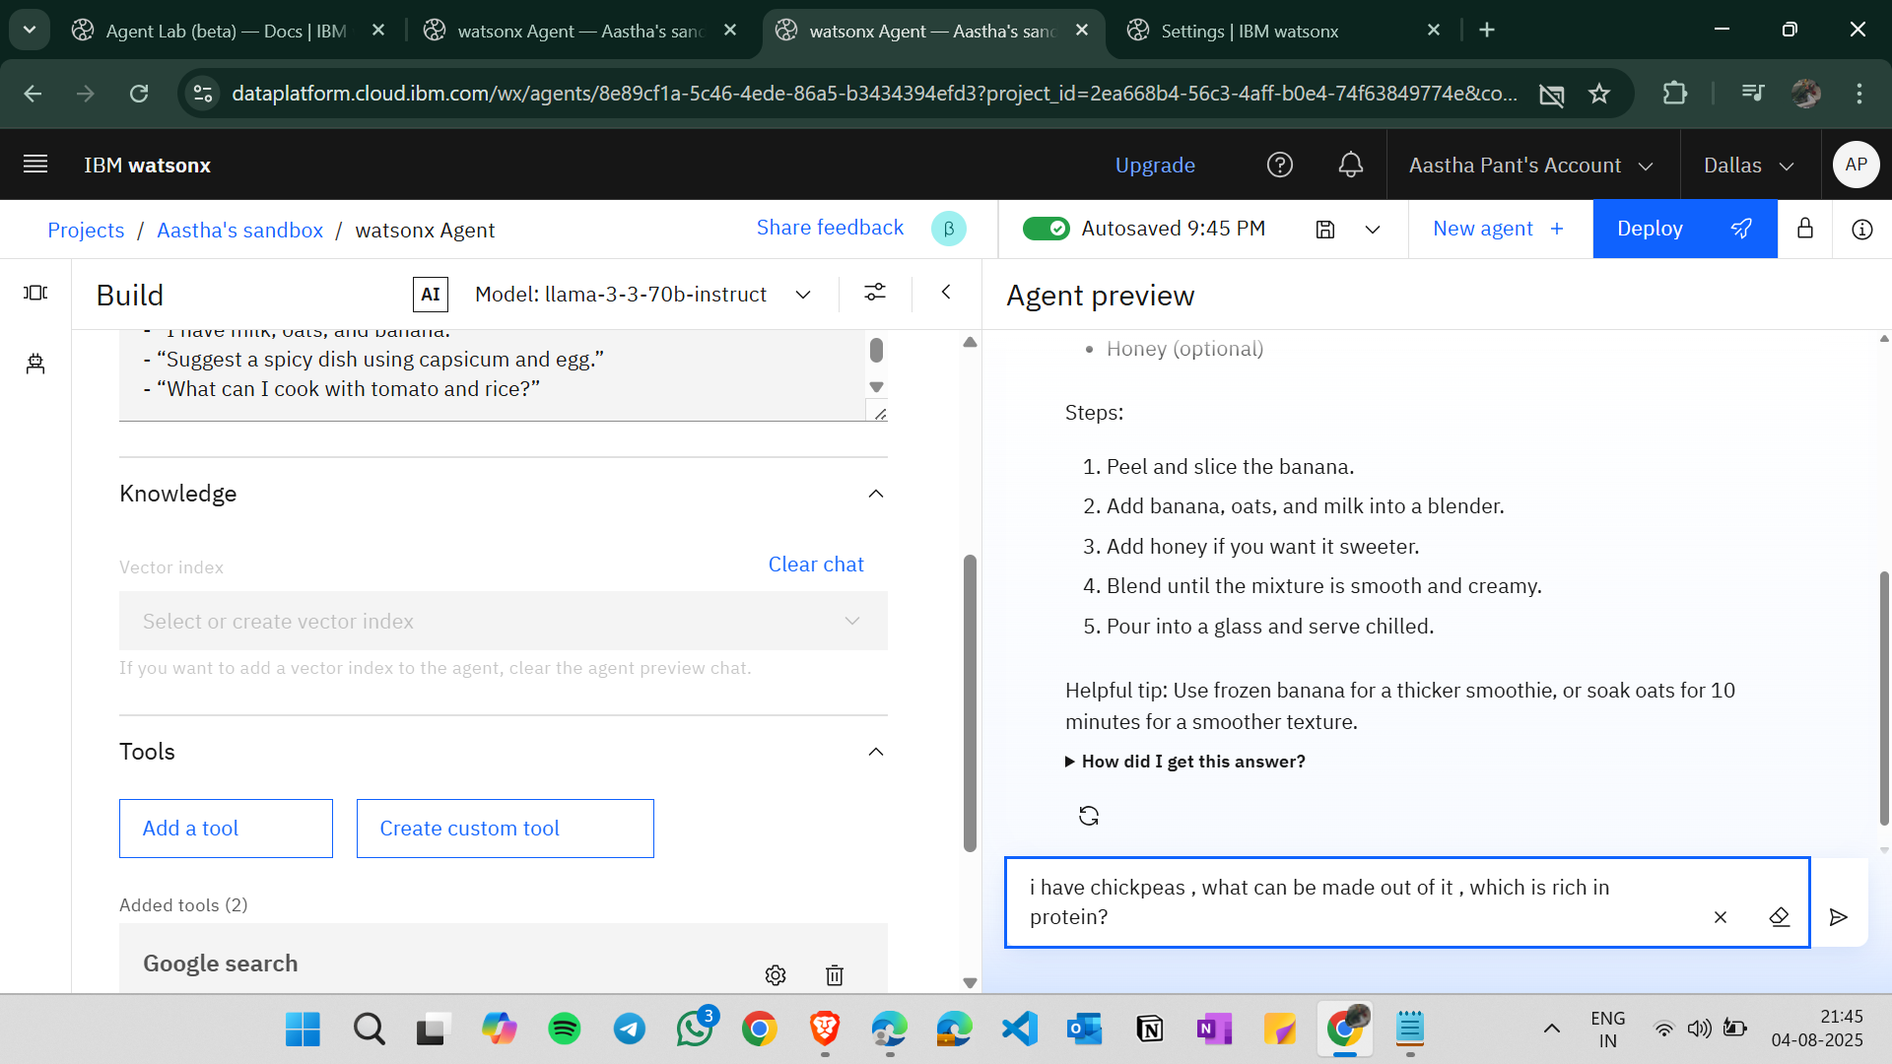
Result
Final giving Prompt and testing.

Slide 13
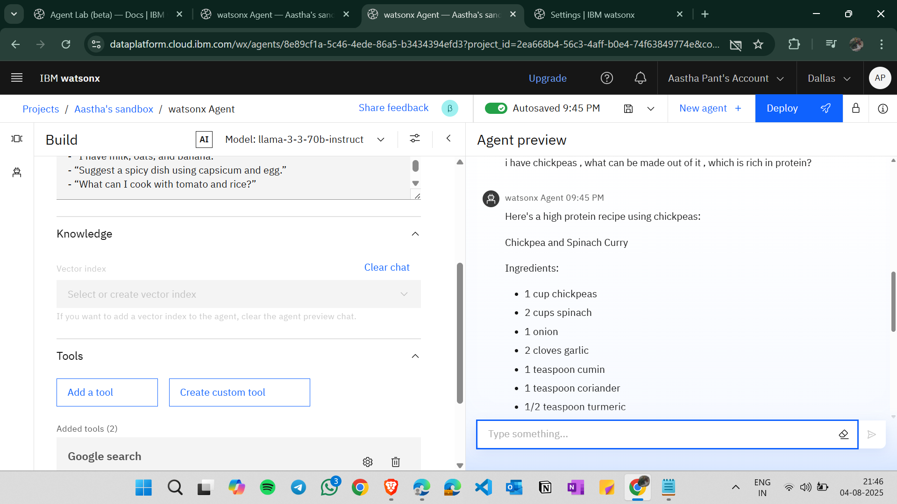
Result
Solution.

Slide 14
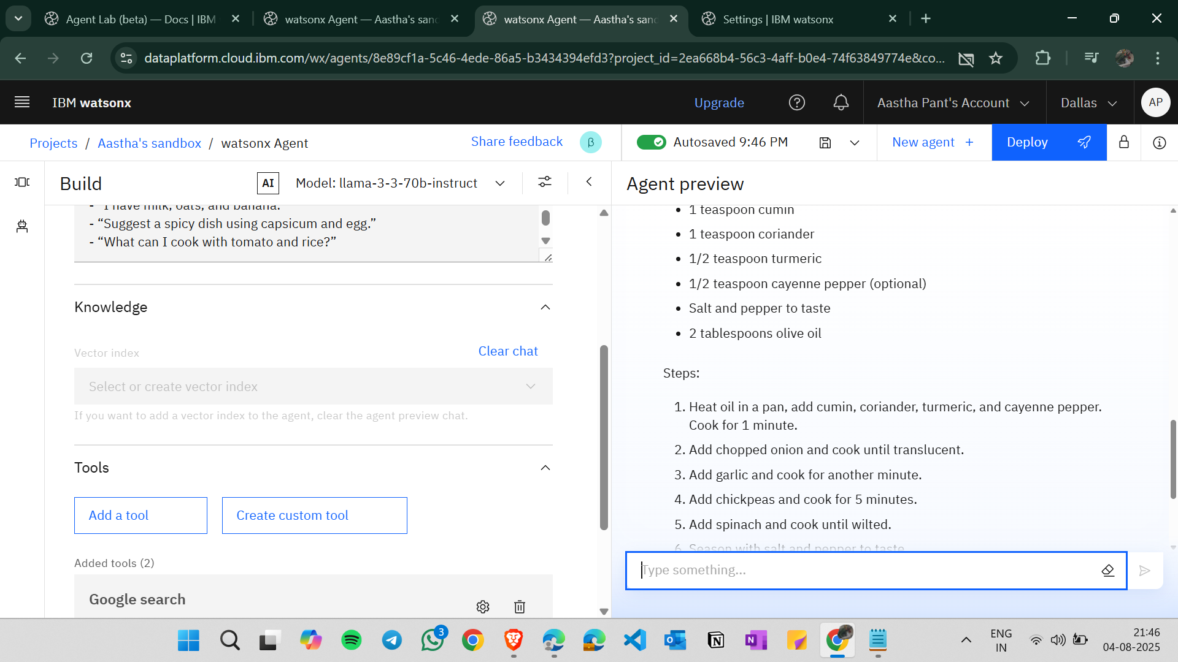
Result
Solution.

Slide 15
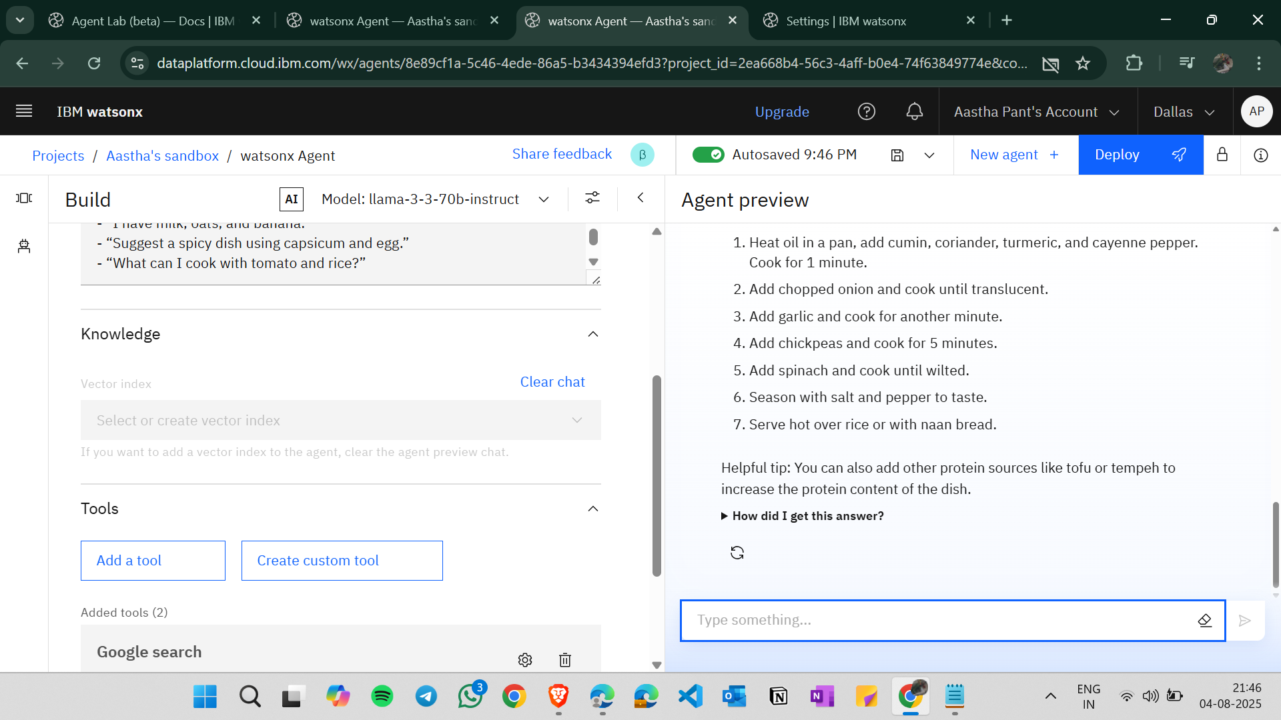
Result
Successful.

Slide 16
Conclusion
The Recipe Preparation Agent successfully demonstrates how AI can simplify cooking with limited ingredients. By using IBM Watsonx and a well-structured prompt with RAG, it delivers accurate and personalized recipe suggestions. This reduces food waste, saves time, and supports sustainable living practices. The agent works smoothly post-deployment and responds accurately to ingredient-based queries.

Slide 17
Future scope
Future scope:
– Expand dataset to include international and regional cuisines.
– Add voice input and speech-based instructions.
– Integrate calorie calculation and nutritional facts.
– Connect with grocery APIs for missing ingredient suggestions.
– Multi-language recipe support for broader audience.

Slide 18
References
IBM Watsonx Documentation
IBM Knowledge Base: Vector Indexing
RAG model principles from Meta AI
Dataset: Custom recipe `.txt` file
https://www.ibm.com/cloud/watsonx
Skillsbuild courses (AI & Cloud)

Slide 19
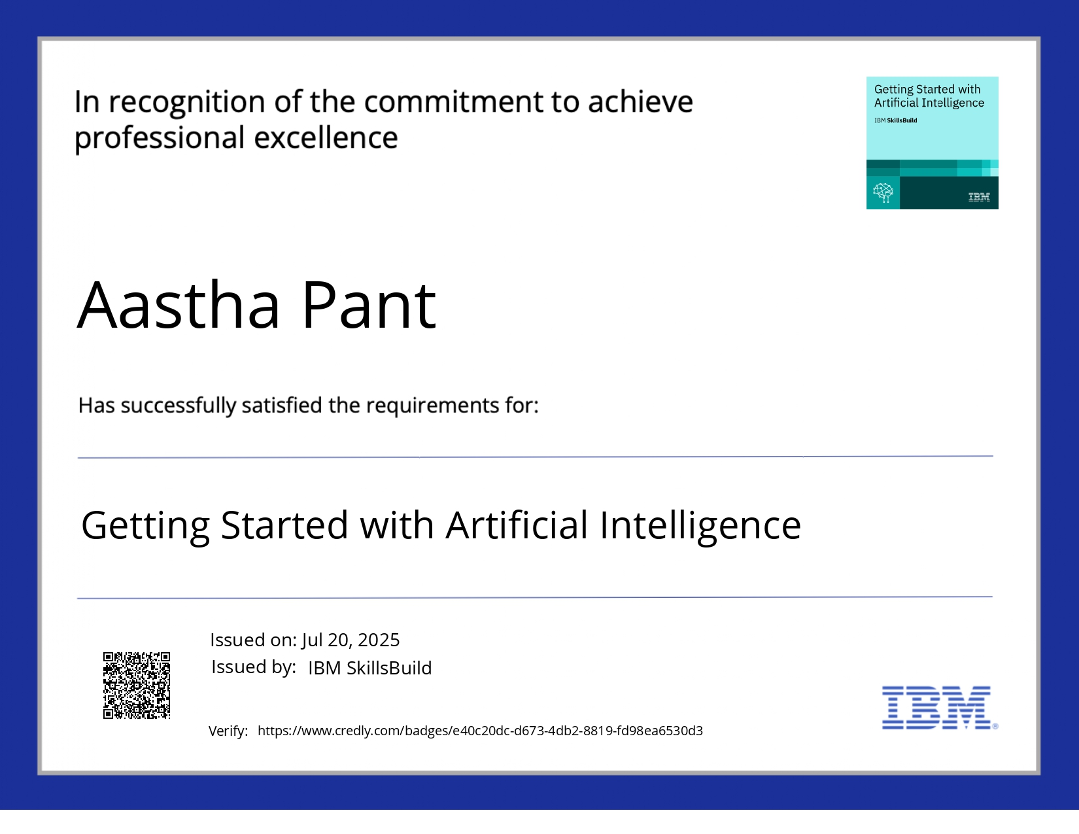
IBM Certifications

Slide 20
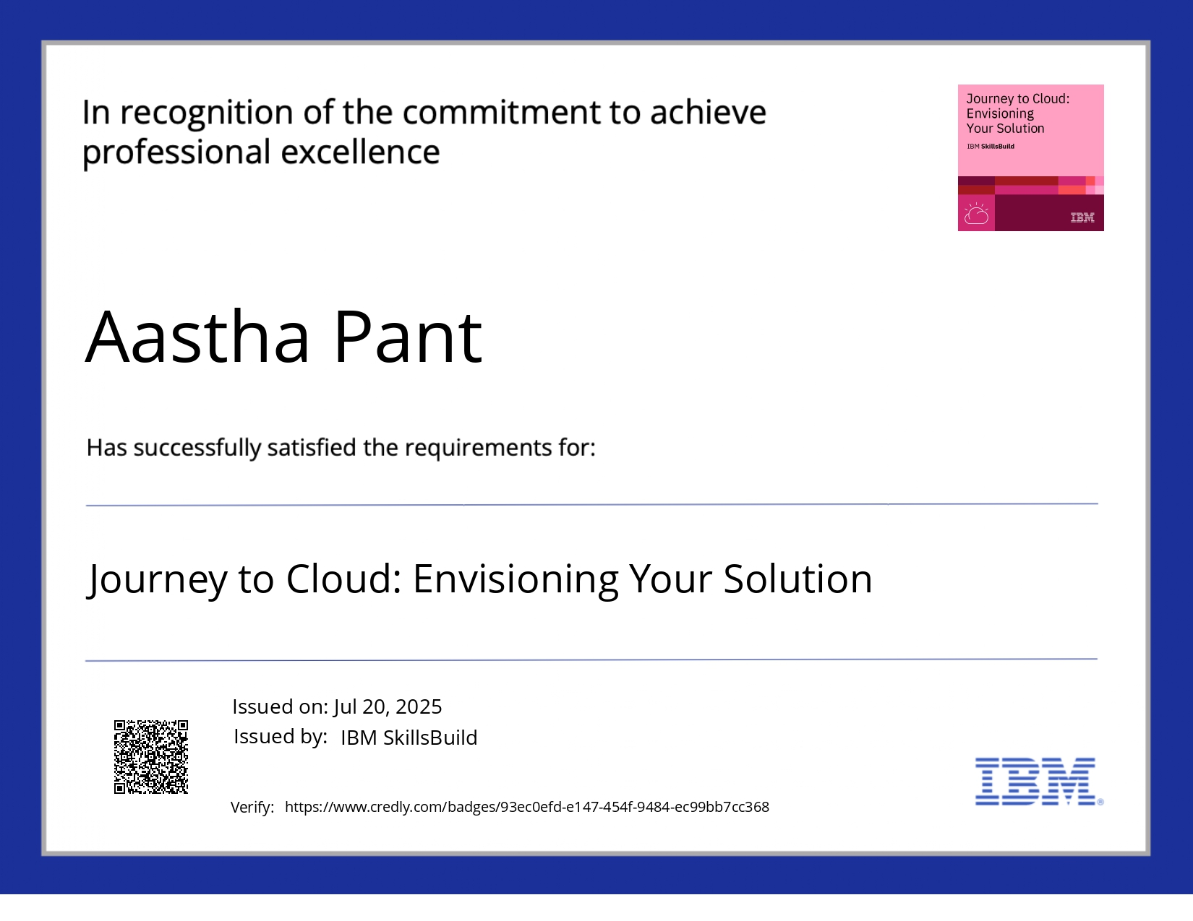
IBM Certifications

Slide 21
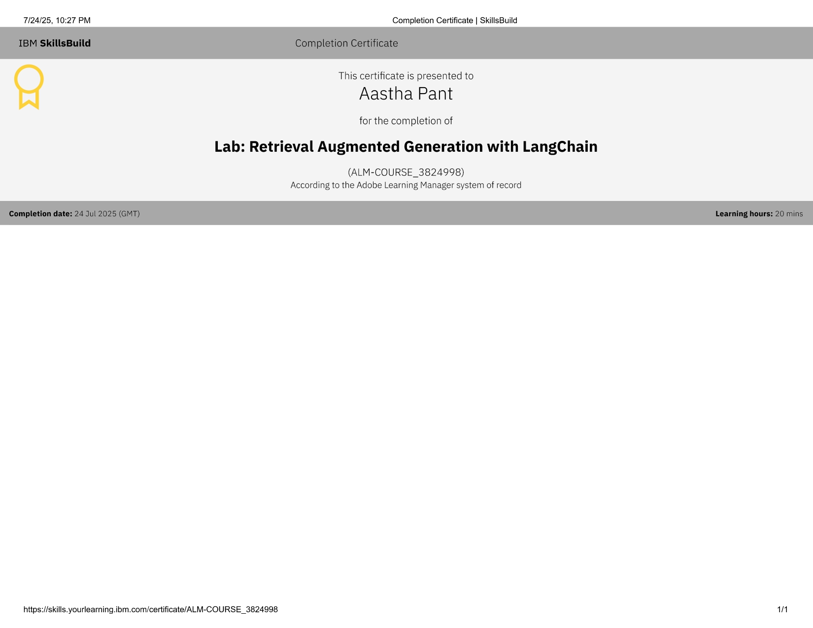
IBM Certifications

Slide 22
THANK YOU

